Slide 1

The Aga Khan Hospital Dar es Salaam
Dr. Mohamedraza Ibrahim - OPA Documentation Compliance for Q4 2022

Slide 2
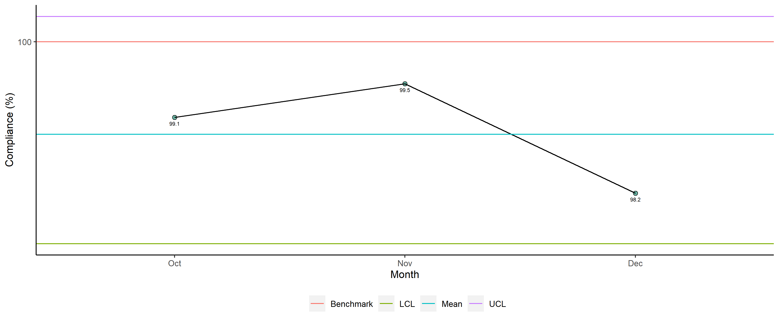
Dr. Mohamedraza Ibrahim - Availability of Required Documents

Slide 3
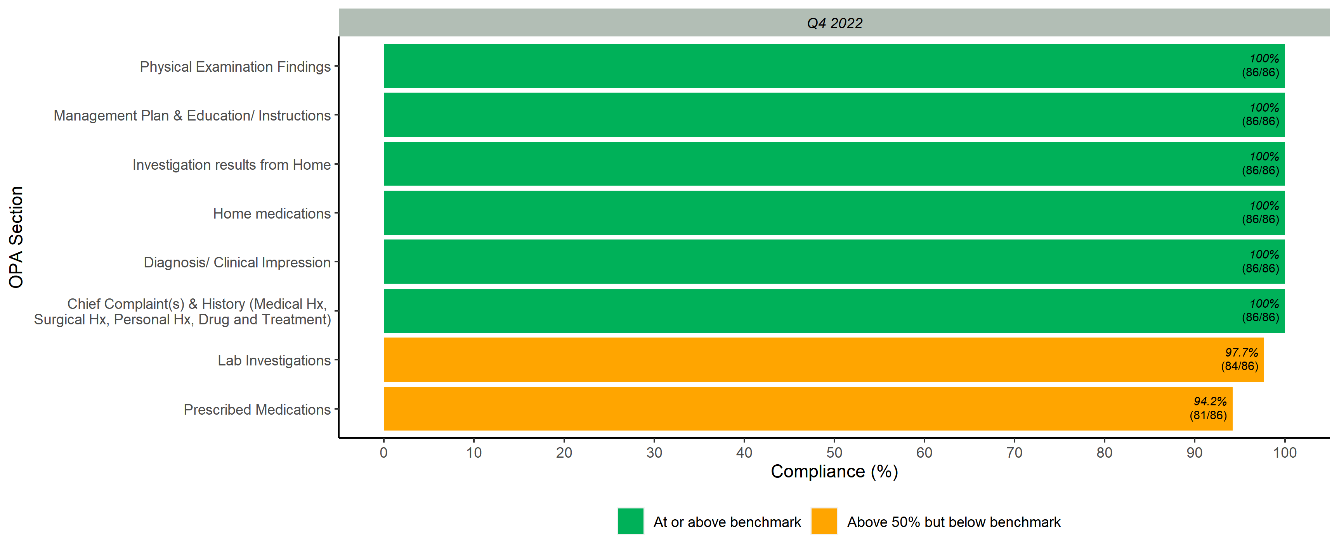
Documented Scores per OPA Section

Slide 4
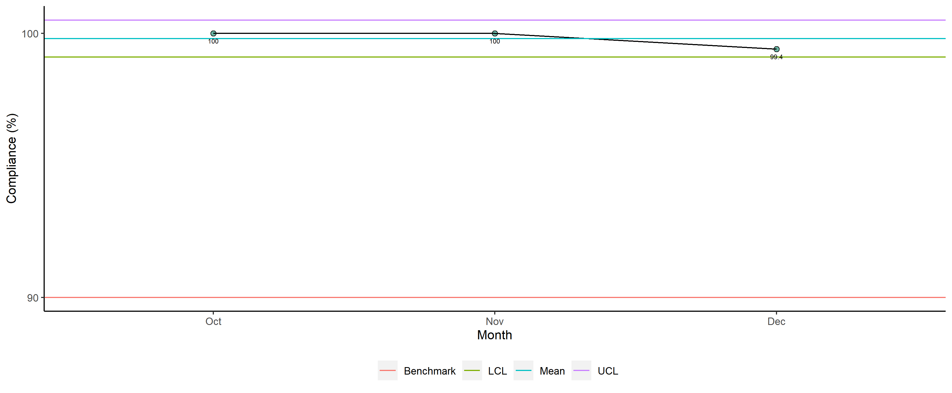
Dr. Mohamedraza Ibrahim - Legibility

Slide 5
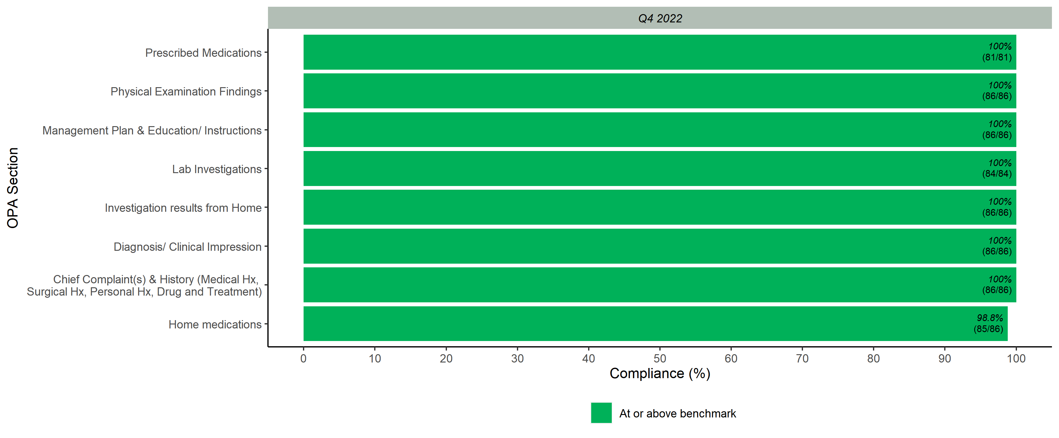
Legibility Scores per OPA Section

Slide 6
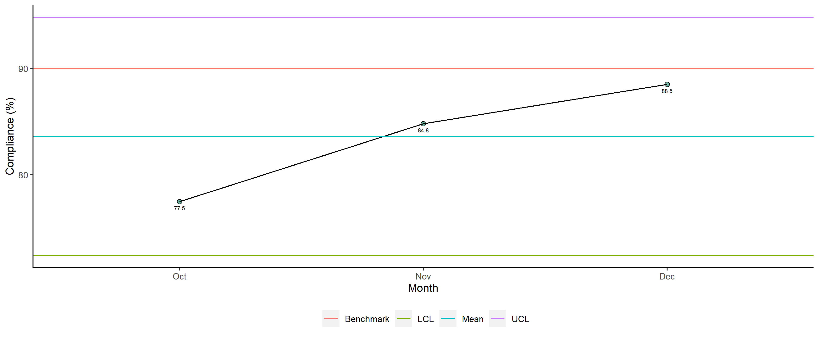
Dr. Mohamedraza Ibrahim - Completeness

Slide 7
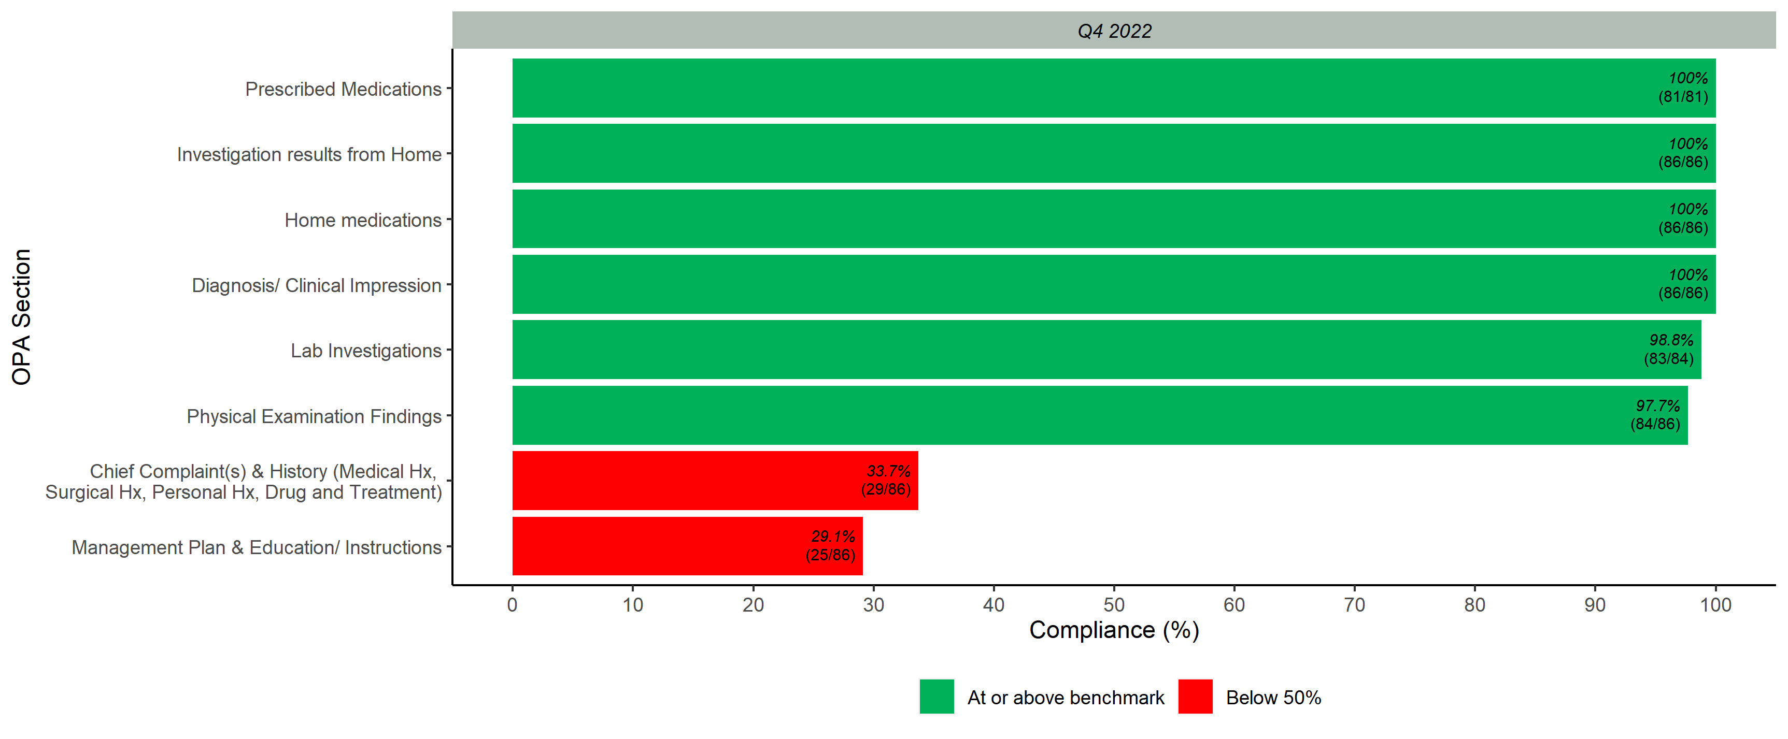
Completeness Scores per OPA Section

Slide 8
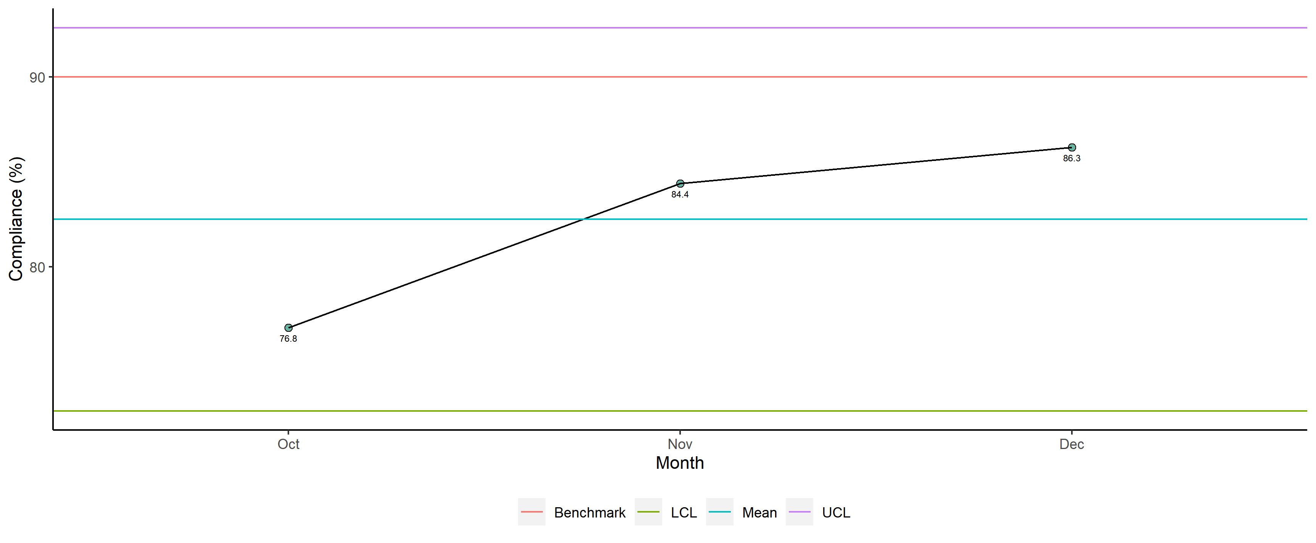
Dr. Mohamedraza Ibrahim - Overall

Slide 9
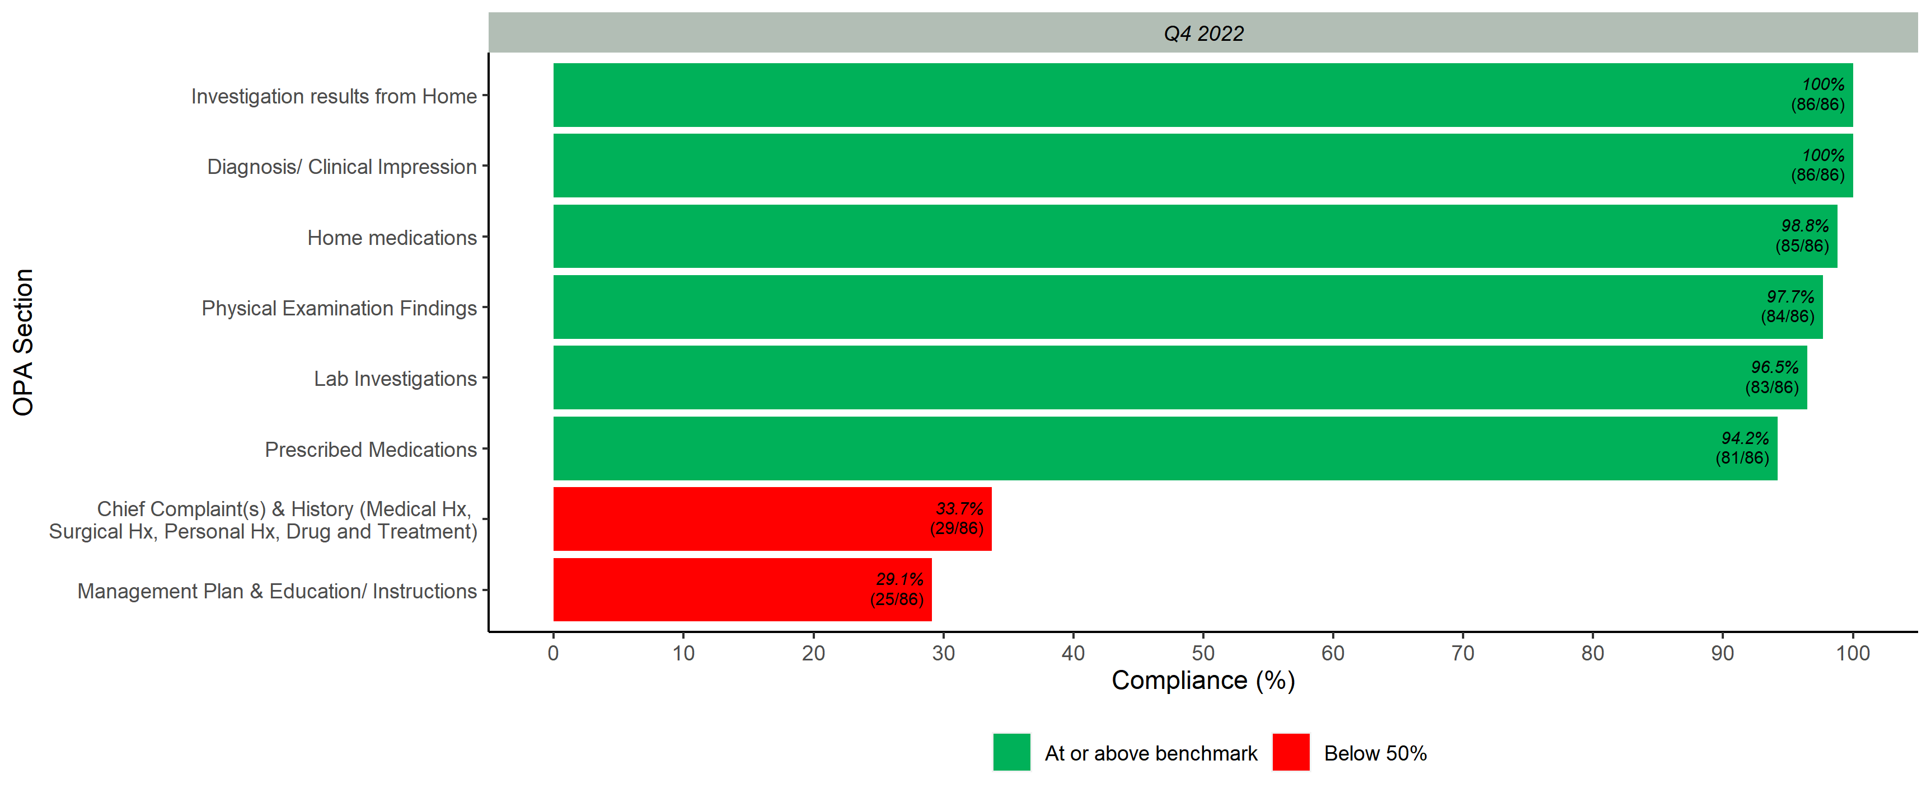
Overall Scores per OPA Section

